Slide 1

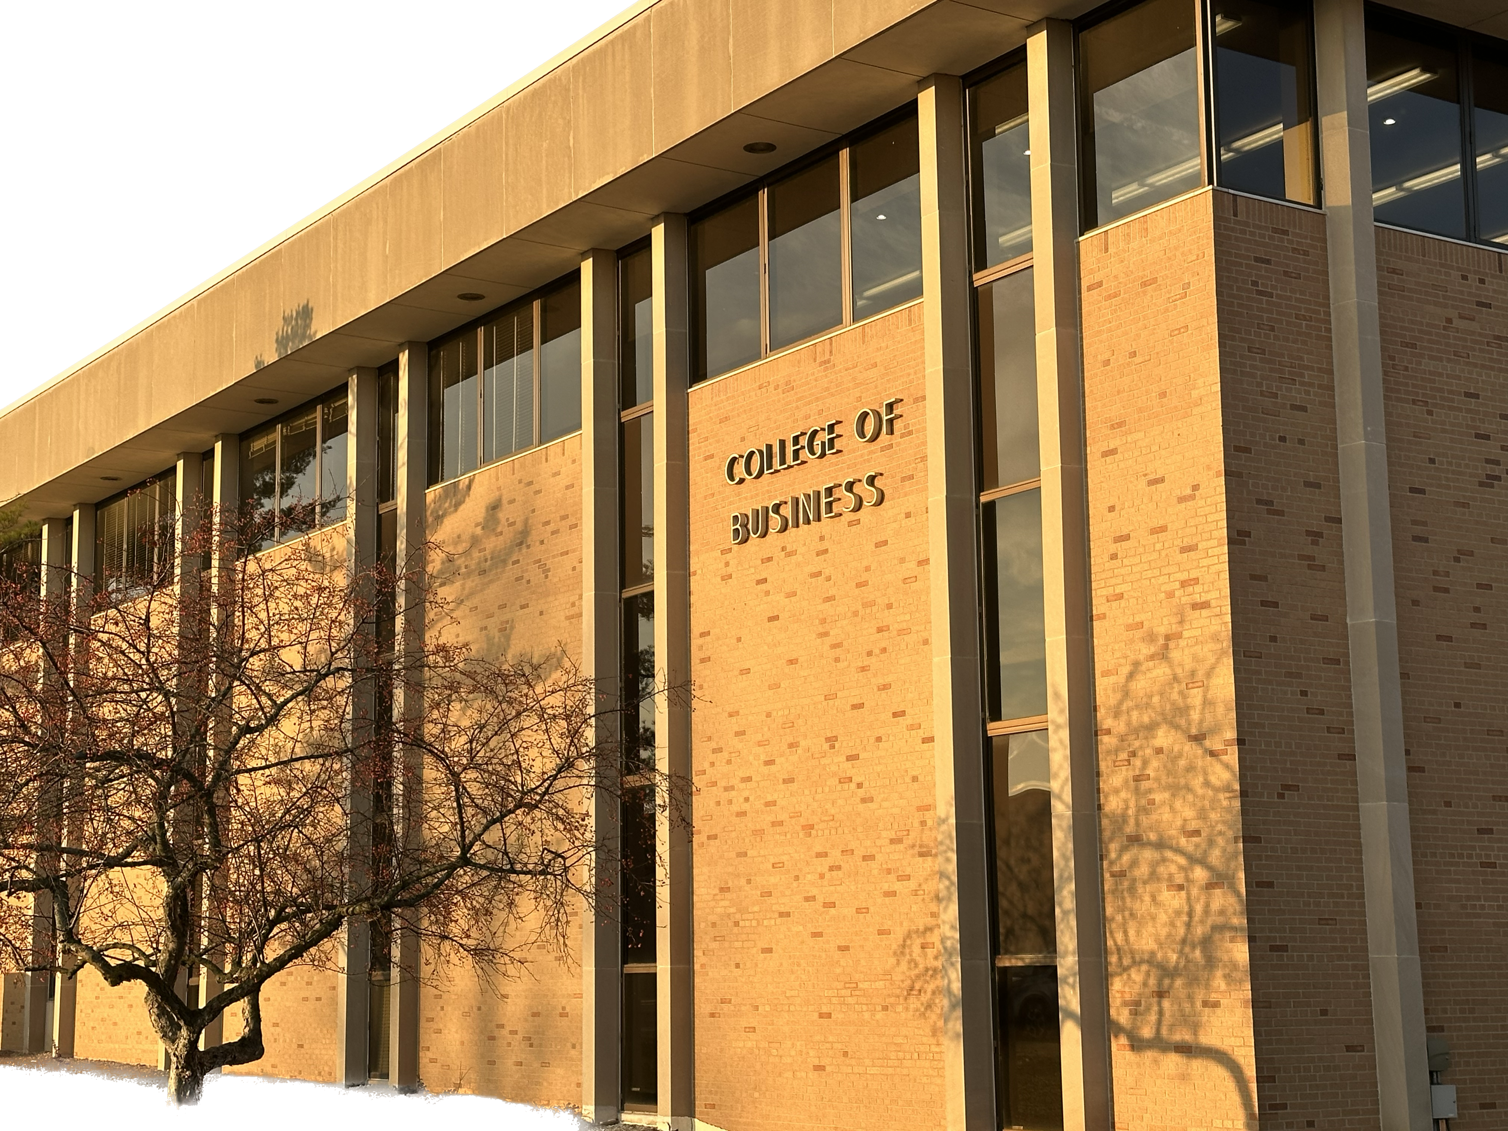
Welcome to the
CIS & CIT Program Advisory Board
November 10, 2022

Slide 2

Agenda
Computer Information Technology
Computer Information Systems
Job Opportunities & Salaries
Program Highlights
Why Ferris?
Career Paths

Slide 3

Computer Information Technology
Our goal to prepare our students to be “Day 1 Ready”

Slide 4


CIT Career Opportunities
Computer Support Specialists **
Maintain computers and networks and provide technical help to computer users. Entry-level (Help Desk)
Network and Computer Systems Administrators
Responsible for the day-to-day operation of computer networks.
Computer Network Architects
Design and build data communication networks, including local area networks (LANs), wide area networks (WANs), and Intranets including virtual capabilities such as a cloud infrastructure.

Slide 5

Career Leadership Opportunities in CIT and CIS
Information Technology Project Managers
CIT
Computer and Information Systems Managers
CIS
vs
Plan, initiate, and manage information technology (IT) projects.
Serve as liaison between business and technical aspects of projects.
Monitor progress to assure deadlines, standards, and cost targets are met.
Plan, direct, or coordinate activities in such fields as
data processing,
information systems,
systems analysis, and
computer programming.

Slide 6
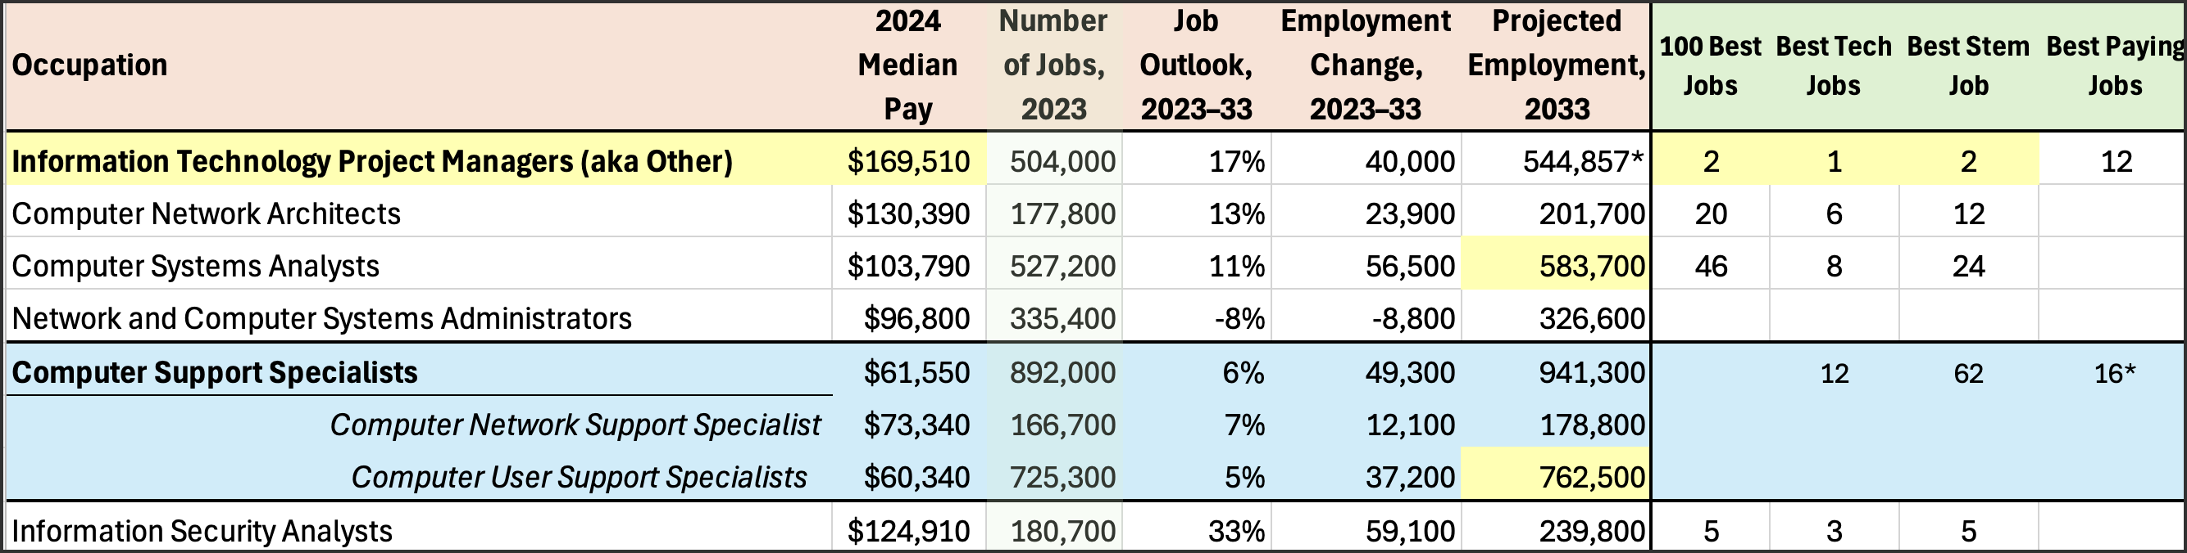
CIT Salaries & Job Projections
#1 Best Technology Job
High salaries and lots of jobs available
Long-term career & leadership opportunities
US BLS & https://money.usnews.com/careers/best-jobs/it-manager

Slide 7

CIT Program Highlights
3 Degree Options:
Minor
Associate
Bachelor
Key Experiences:
Internship Requirement
Senior Projects course
COB Business Courses
3 Industry Certifications
Courses – Credit for Certification!
A+ (6)
Network+ Administration (3)
Linux+ Administration (3)
Server Administration (3)
Office Applications (3)
Other Key Courses:
Client Administration
Virtual Systems /Cloud+
Security+ Administration
IT Management
Python Programming
Databases

Slide 8
Computer Information Systems

Slide 9
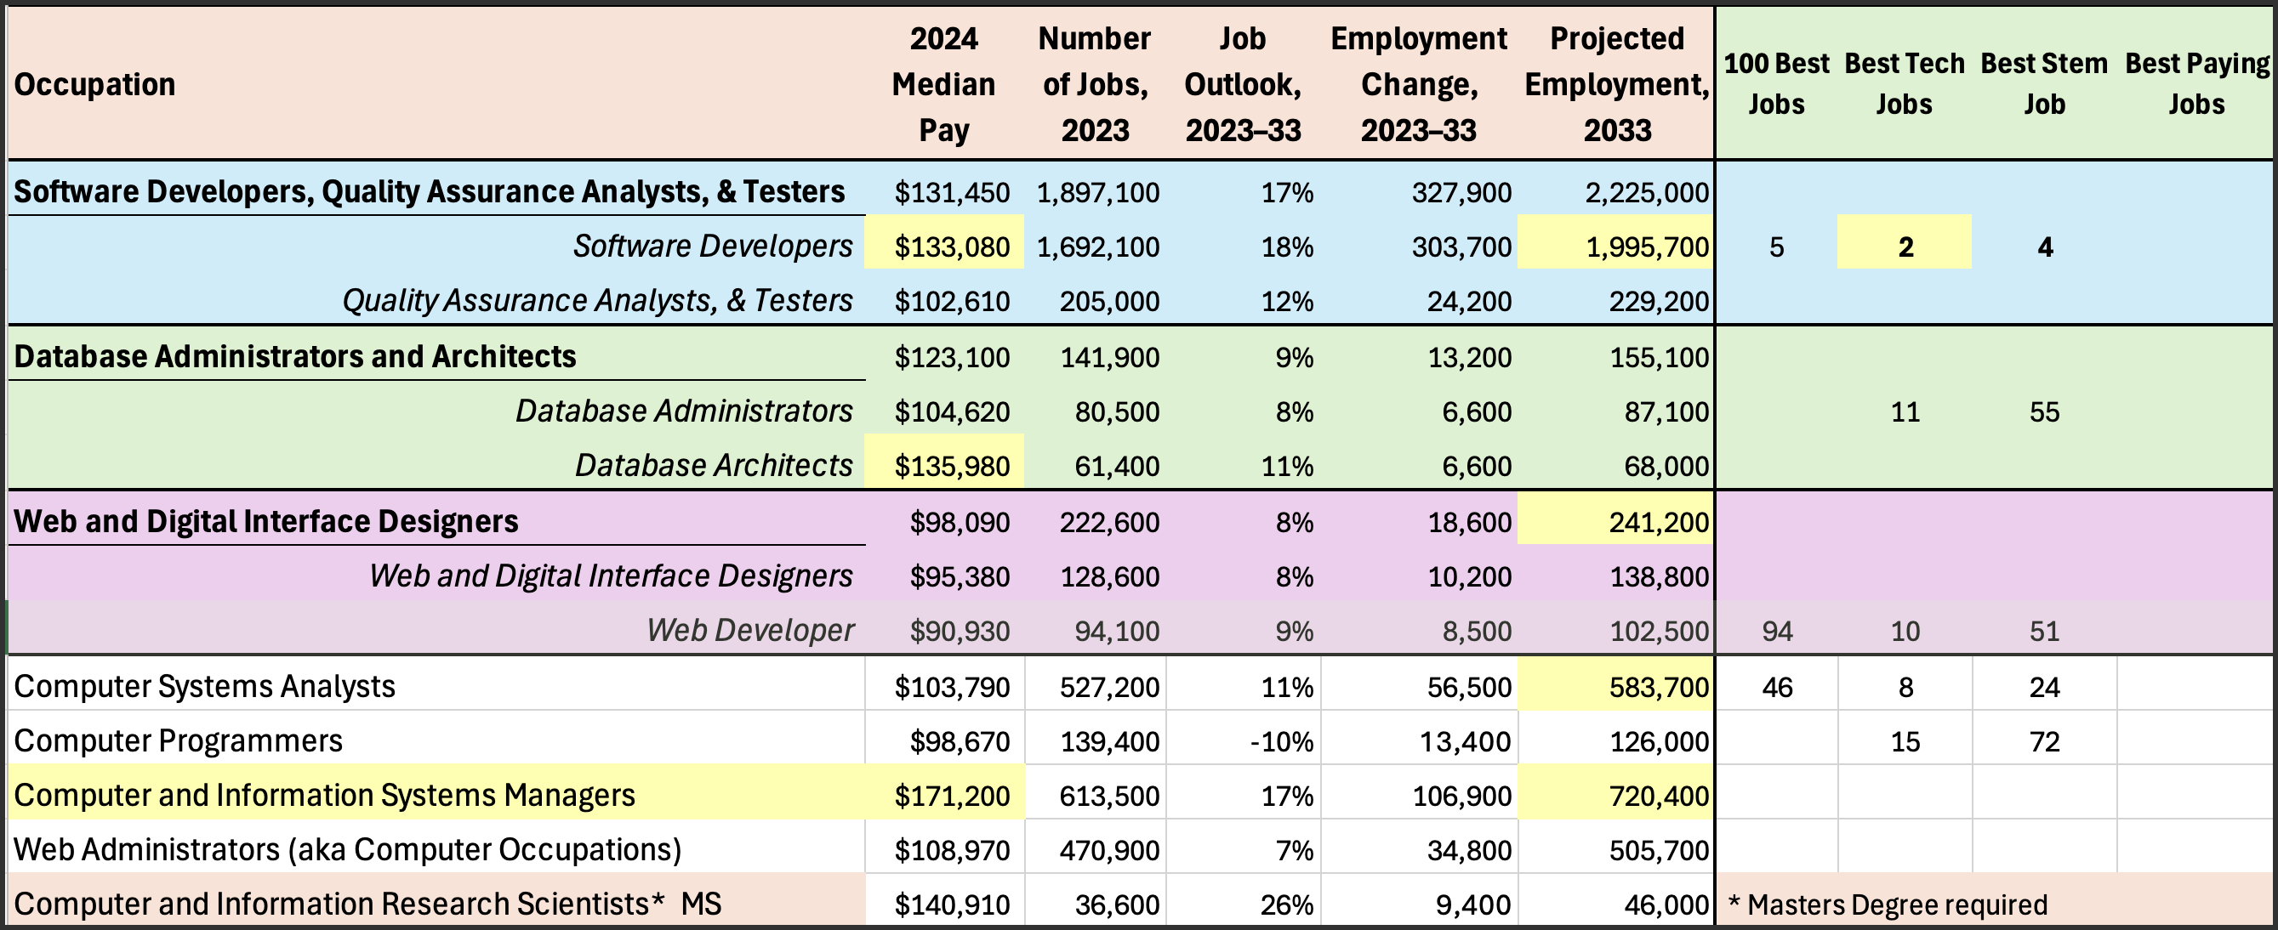
CIS Salaries & Job Projections
Software Developer is the #2 Best Technology Job
Lots of jobs and a variety of career options
High salaries & leadership opportunities

Slide 10
CIS Program Highlights
3 Degree Options:
Minor
Associate
Bachelor
Key Experiences:
Internship Requirement
Senior Capstone with real clients
Directed Electives
Faculty integrate new technologies & tools within the courses providing students with marketable skills!
Key Courses:
COB Business Core
Python
Advanced Programming
System Analysis & Design
Mobile Application Development
Web-Based Systems Development
Database Design and Applications
Enterprise Integration & Business Process Design using SAP
Operating System & Networking technologies used to build and deliver integrated applications

Slide 11
Why Ferris?

Slide 12
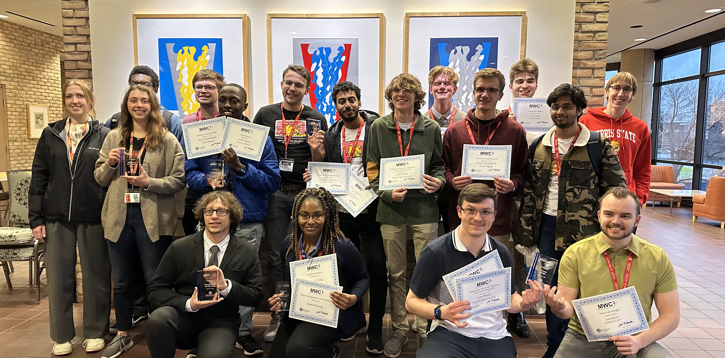
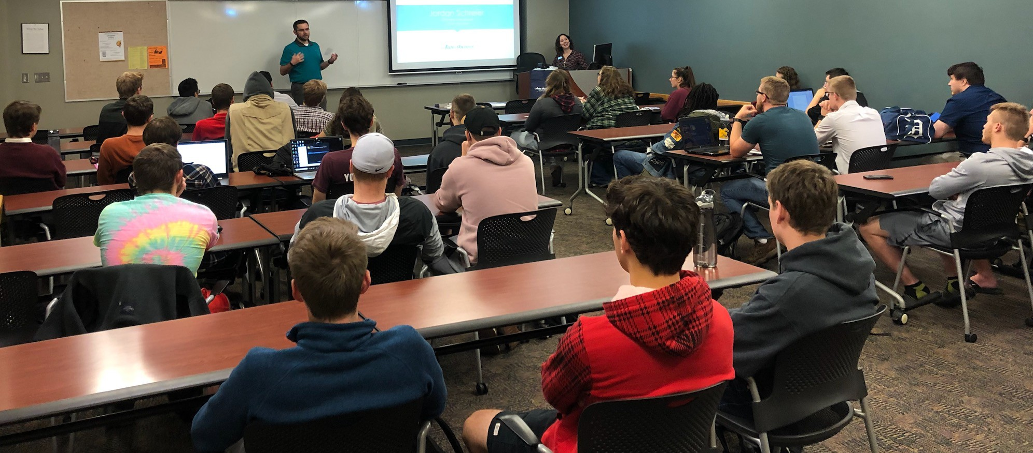
BCP is an Active Student Organization that Connects Students with Alumni & Businesses
Our students from ISIN, CIT and CIS consistently succeed in regional collegiate competitions!

Slide 13
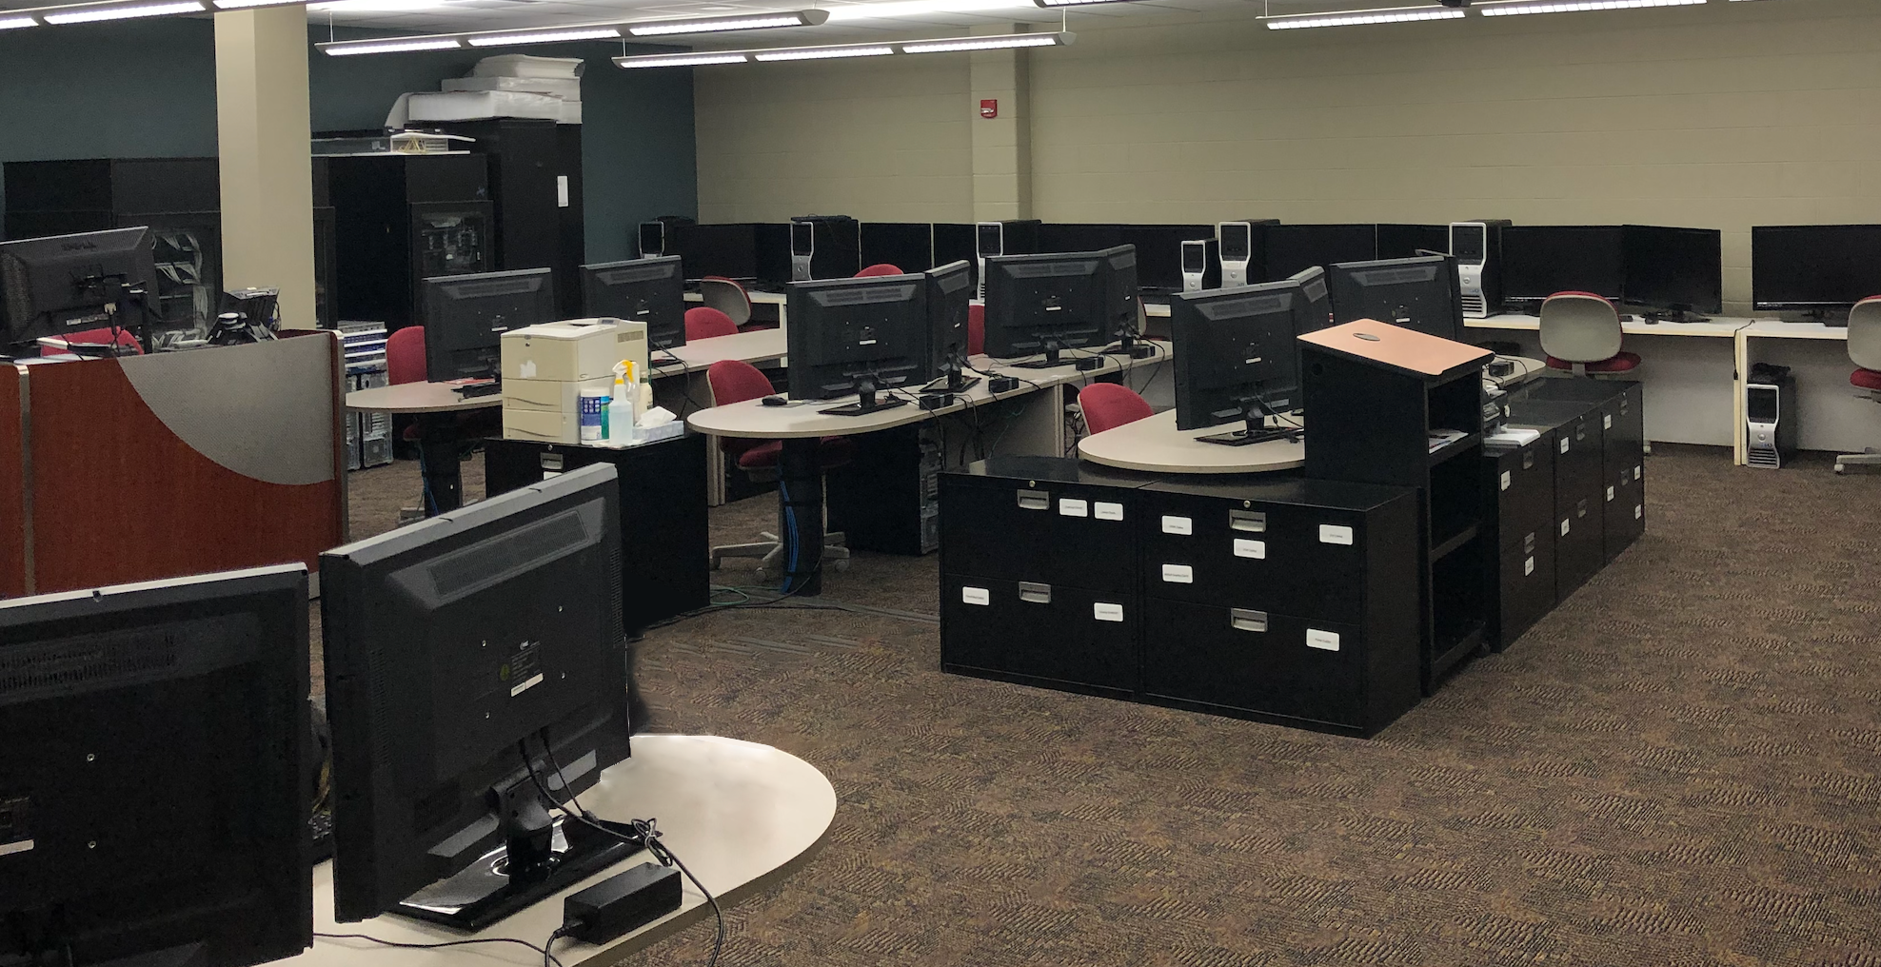
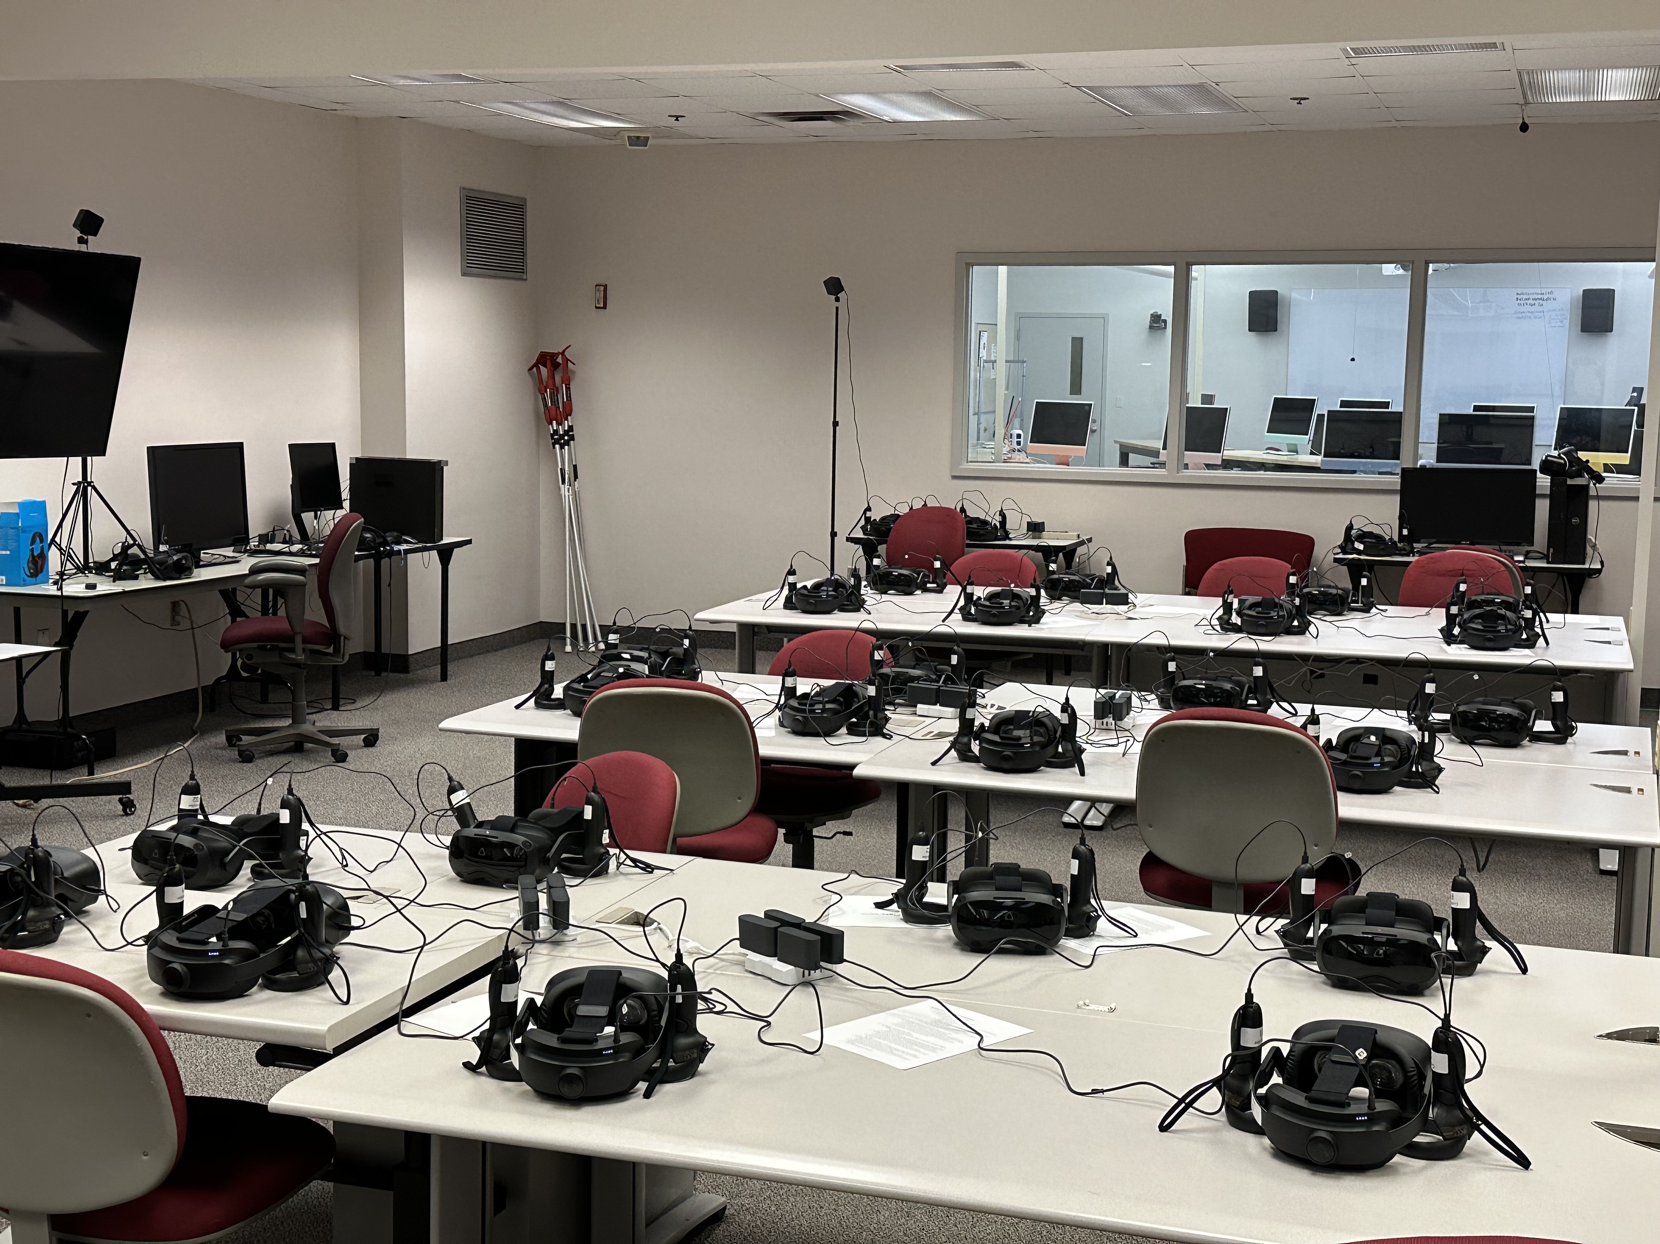
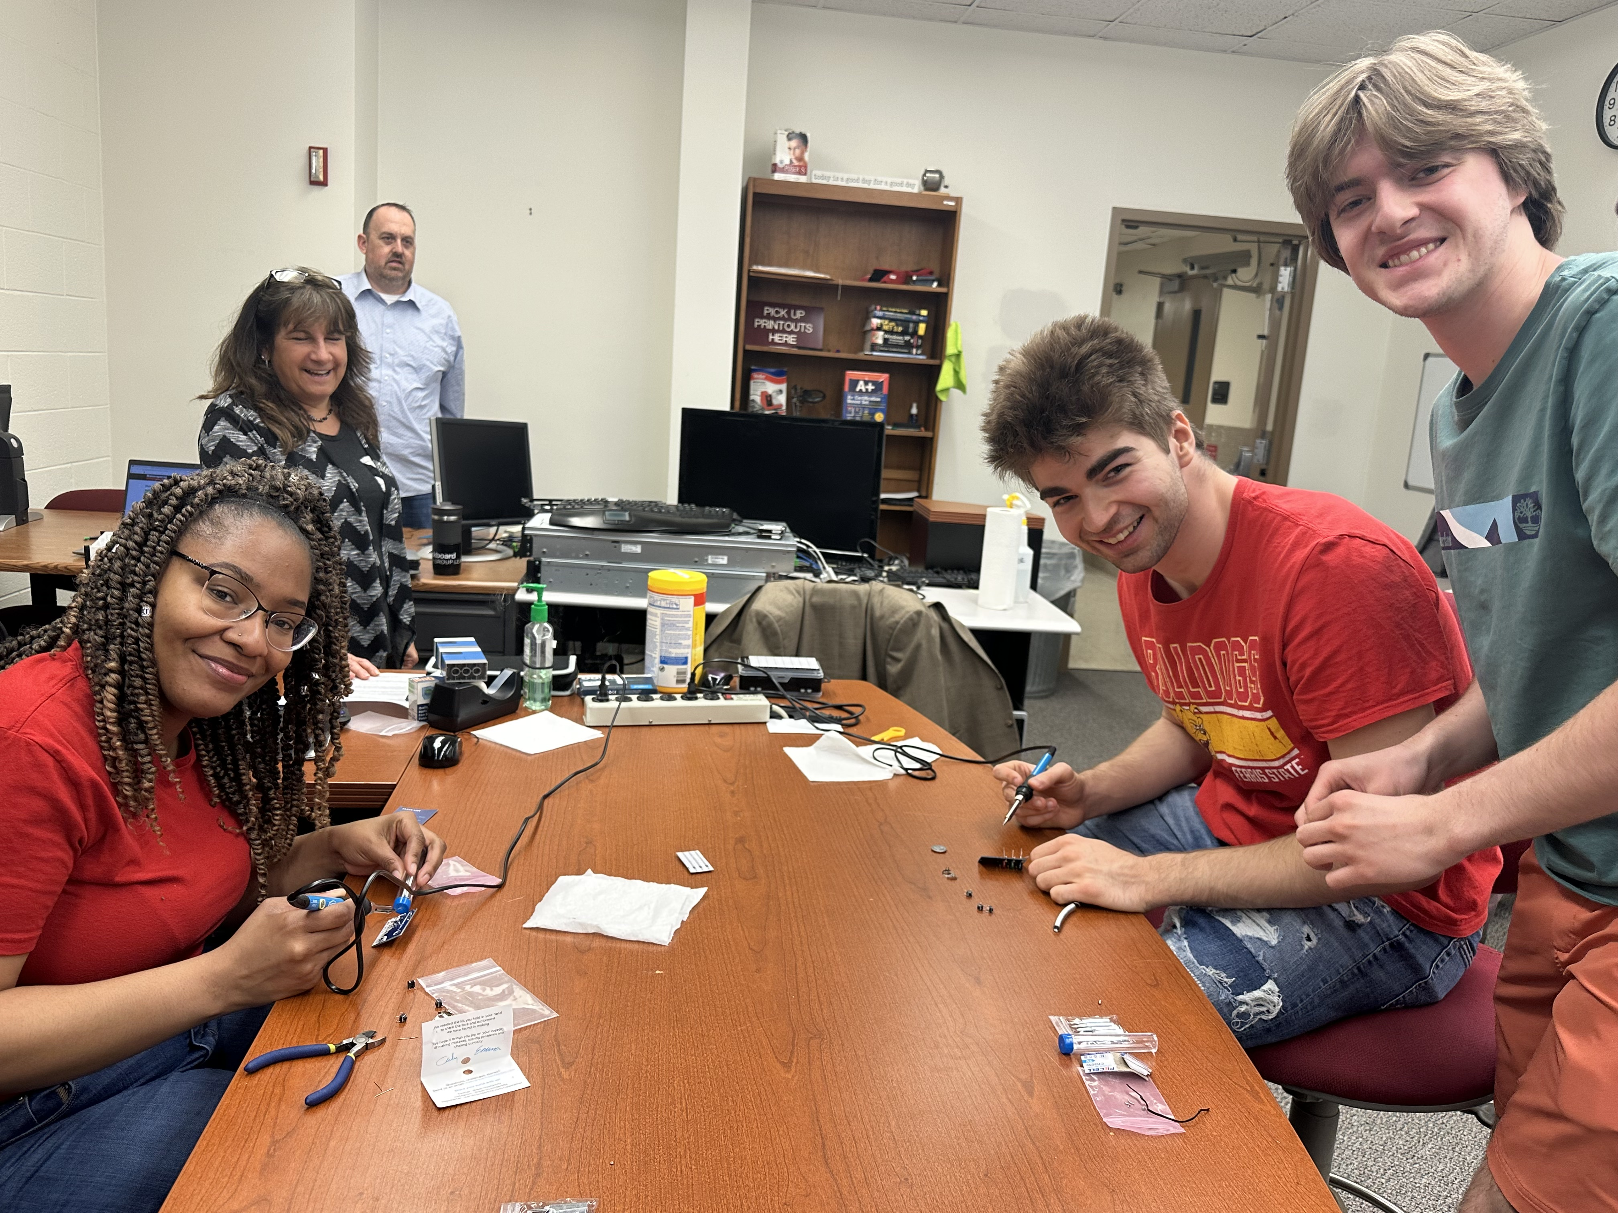
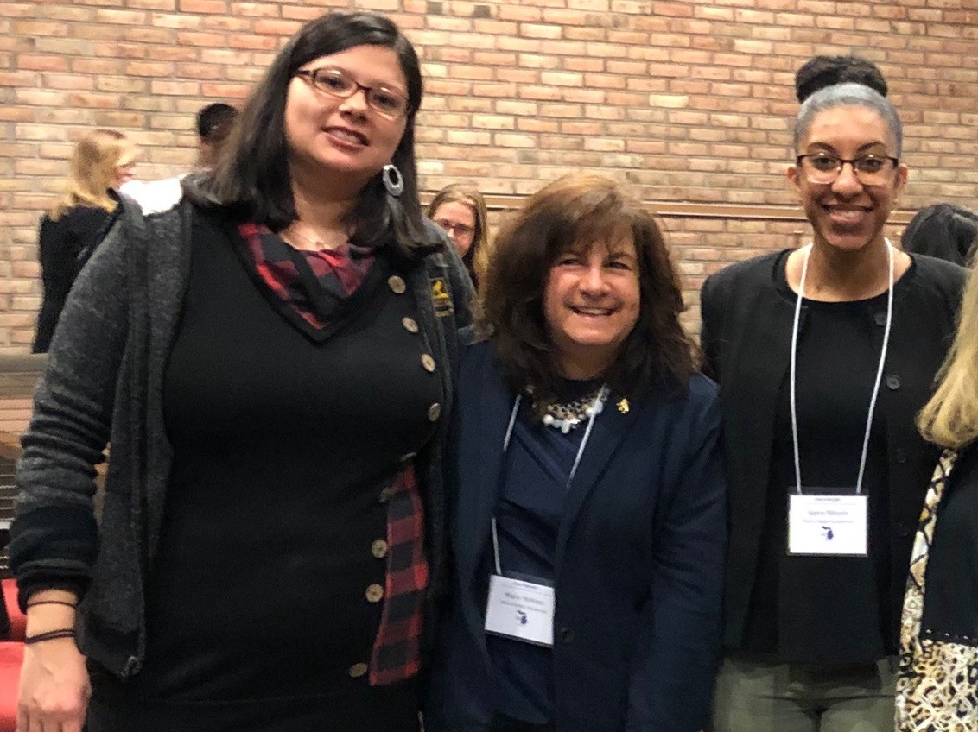
Labs, VR Classroom, Networking Bench Lab Provide Opportunities for Collaboration

Slide 14


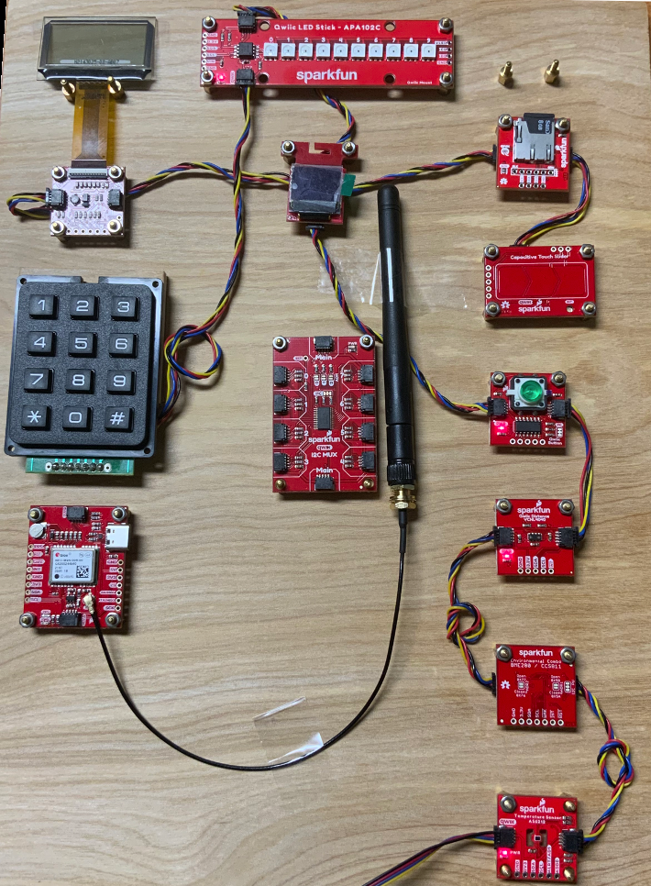











How Students Become Day 1 Ready
Internships and Student Participation in the RSO
Hands-on experiences in the classroom & labs
Senior projects with real clients
Integration of New Technologies in Networking and Software Development

Slide 15
Tip for Choosing a Career Path
1. Focus on how programs prepare students for the careers!
2. Highlight the number of jobs available not the rate of growth!

Slide 16
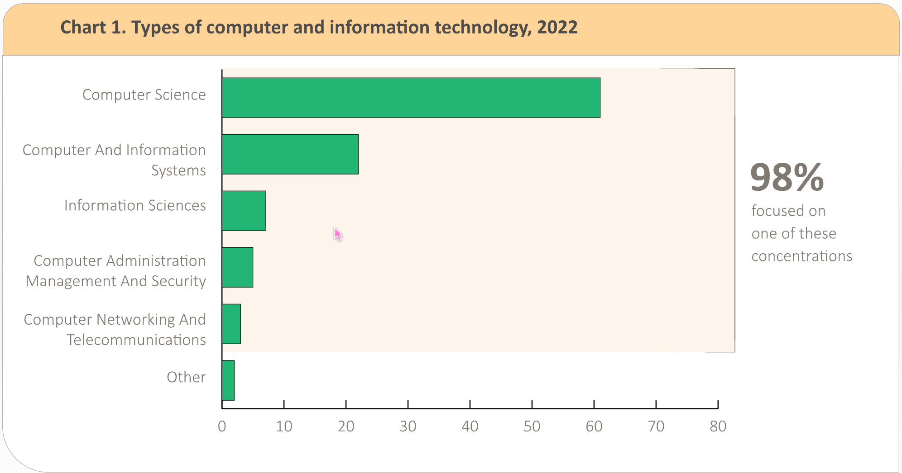
Students Choices in Computing Majors
90% of students choose to major in CS, CS/IS or IS
https://www.bls.gov/ooh/field-of-degree/computer-and-information/computer-and-information-technology-field-of-degree.htm#maj

Slide 17
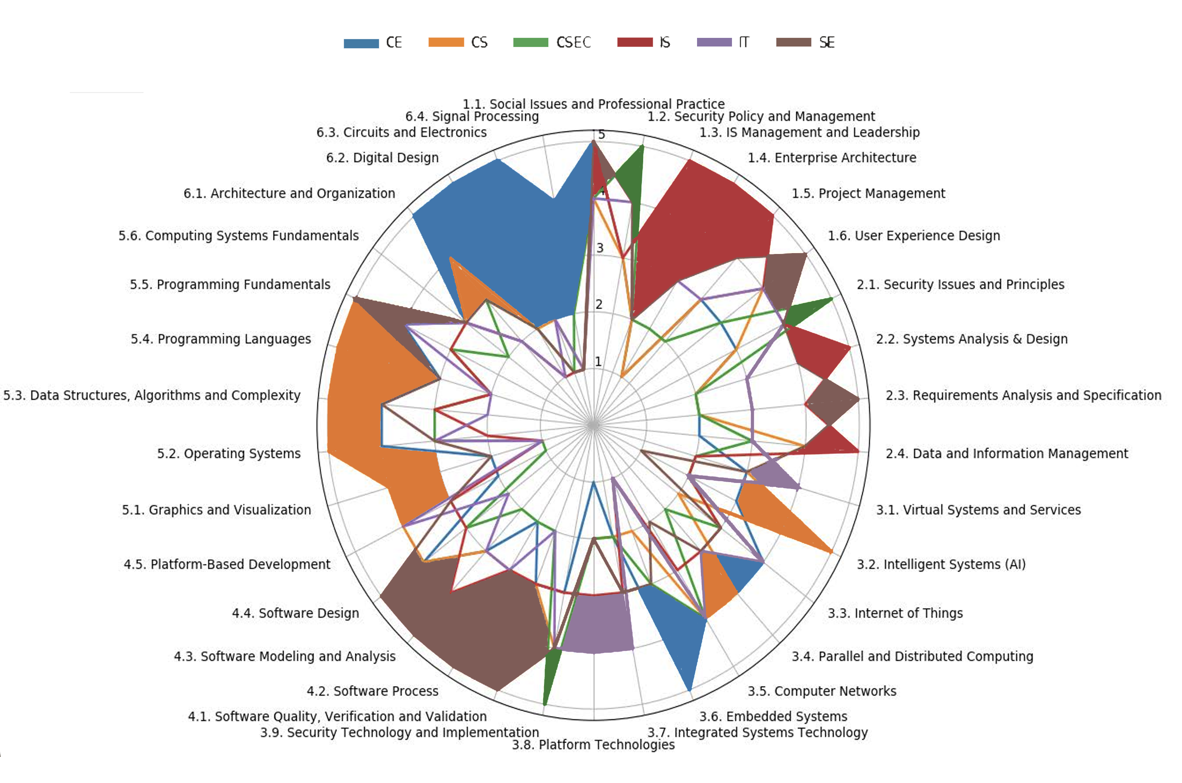
Overlapping Content can be a Challenge for Prospective Students!!!
CC 2020 ACM

Slide 18
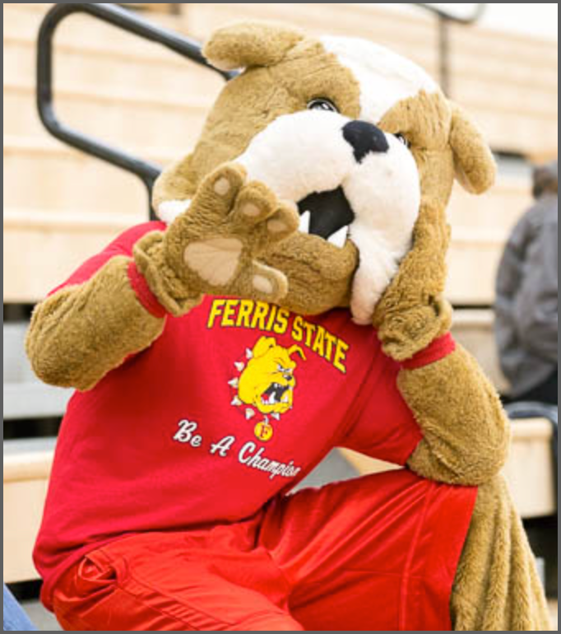
Contact Information
Dr. Kathleen Kalata
Associate Professor Program Coordinator, CIT, CIS BUS 326, College of Business
o: 231.591.2045
c: 906-202-0314
KathleenKalata@Ferris.edu

Slide 19
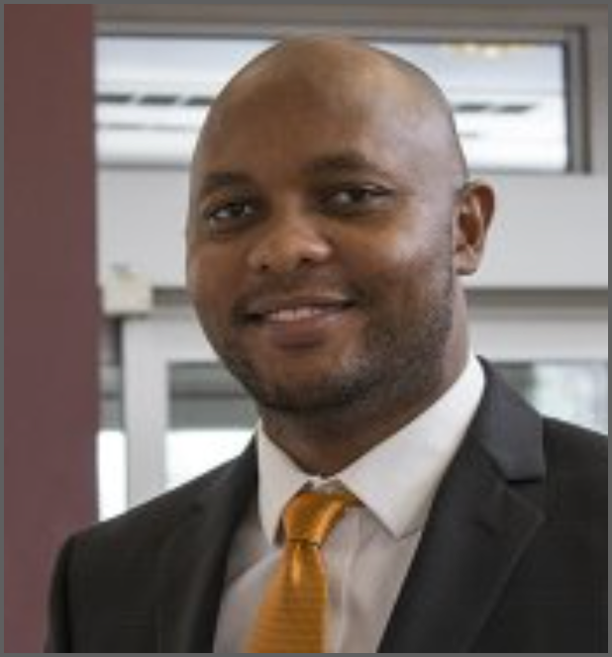
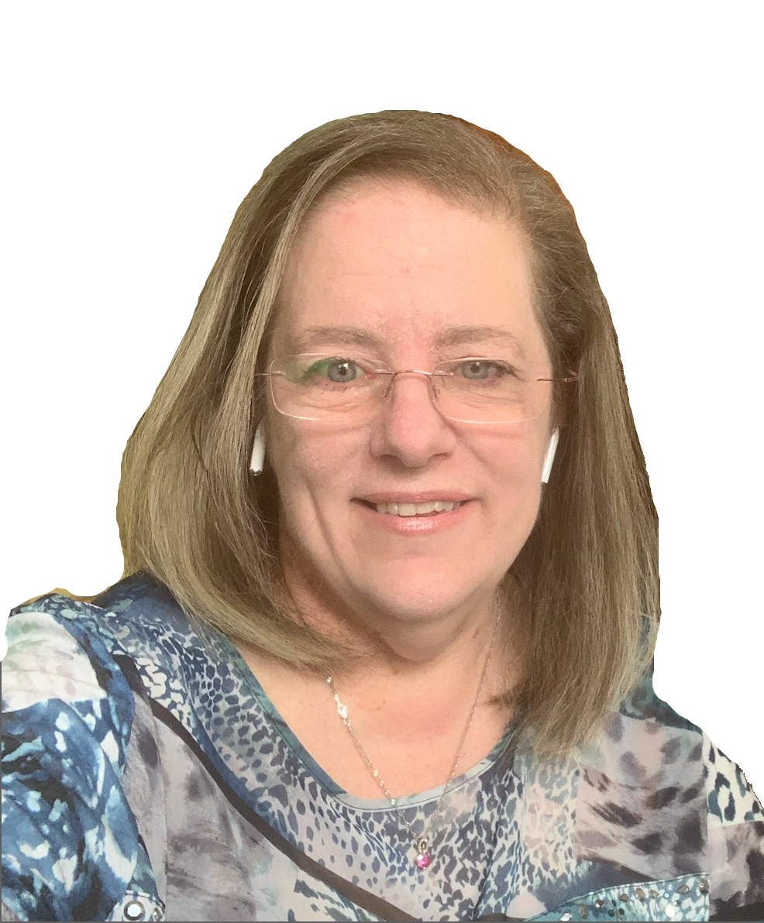
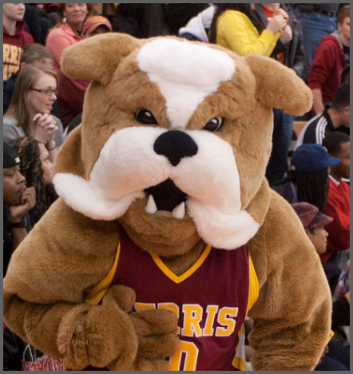

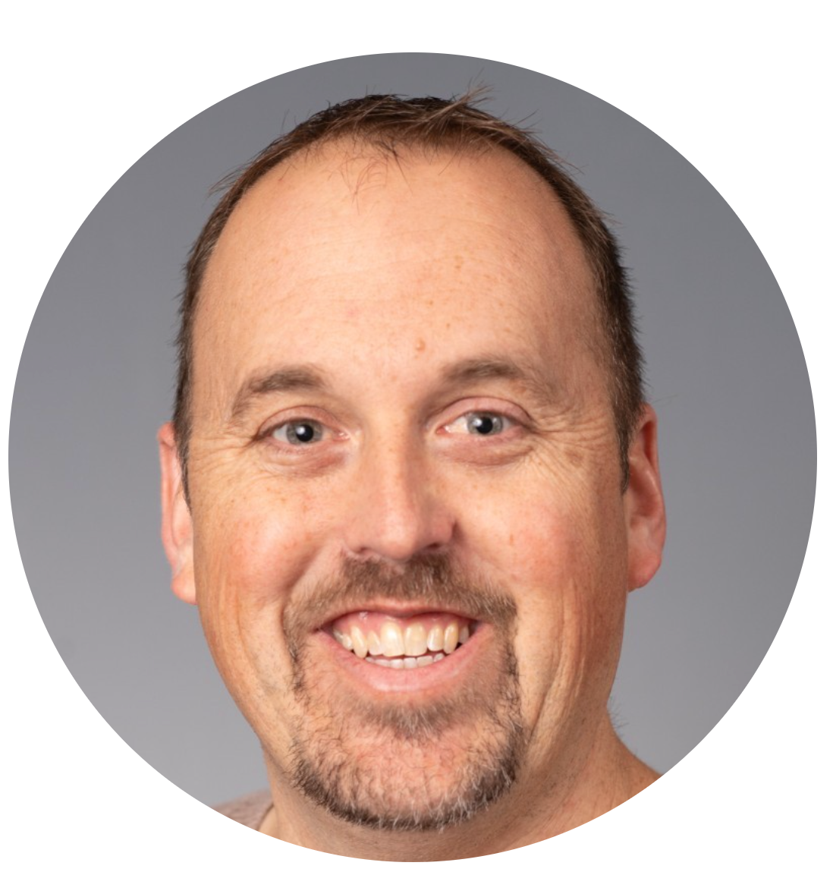
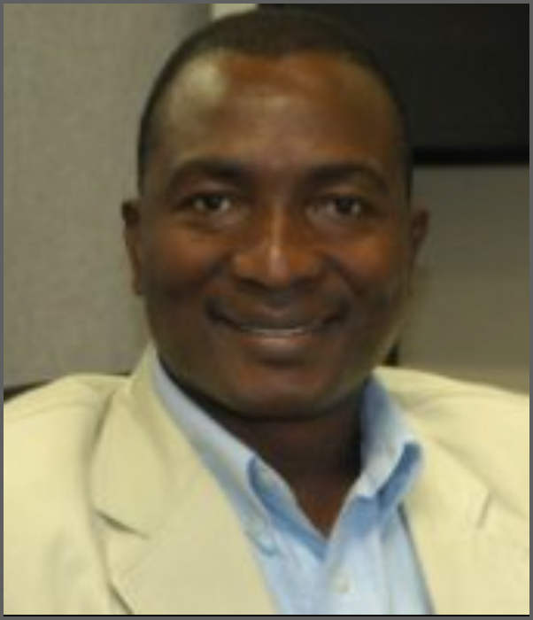
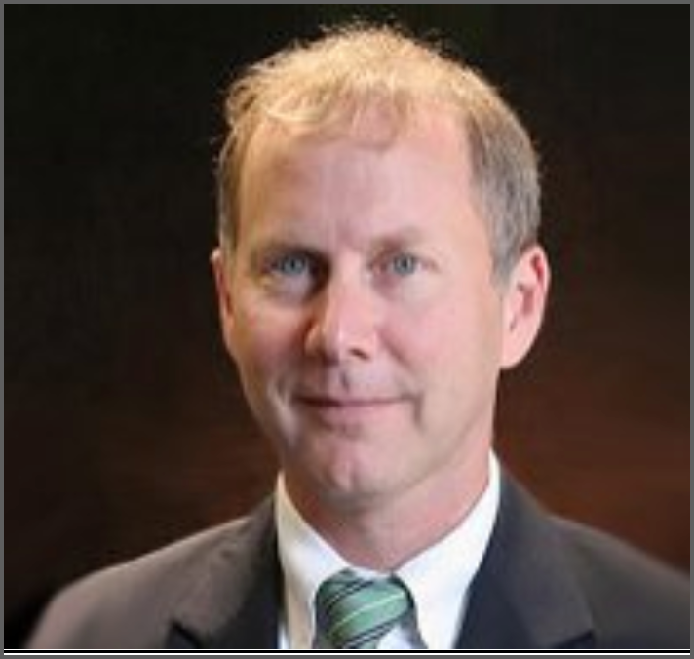
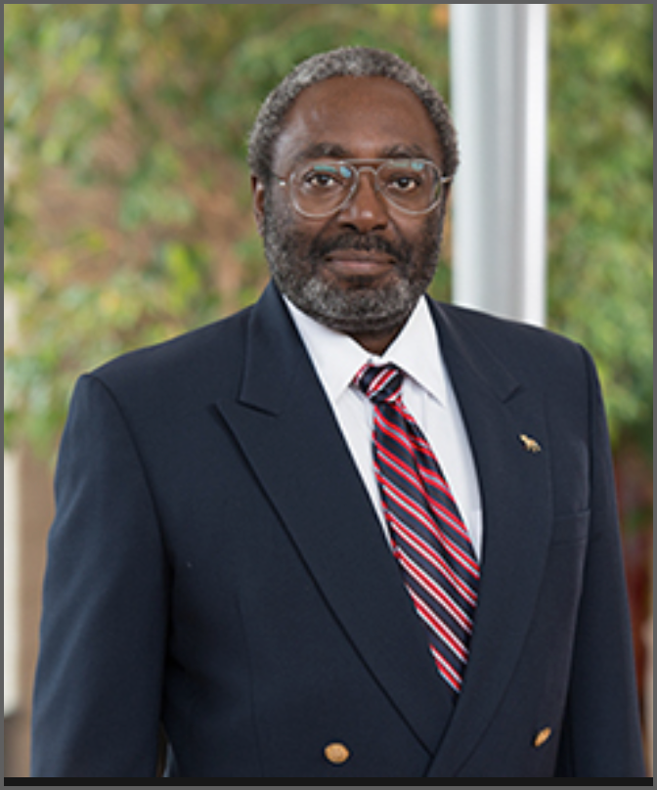
CIT and CIS Faculty
John Kinuthia AFIS Dept Chair |  | Katie Kalata Program Coordinator | Jennifer Njenga Internship Co. | AFIS Staff
Mary Holmes | Travis Bussler | Felix Bollou | Hira Herrington | Jimmie Joseph

Slide 20
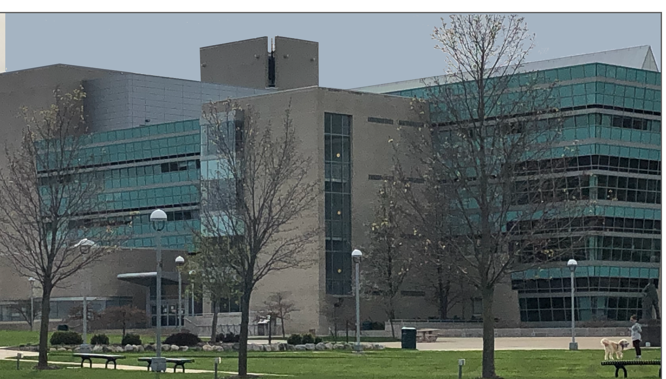
Questions?
Questions?

